Slide 1
What is a Reflection?
Reflection is a generic term that describes the ability to inspect and manipulate program elements at runtime .
Reflection allows you to:
Find out information about an assembly
Find out information about a type
Enumerate the members of a type
Instantiate a new object
Execute the members of an object
Inspect the custom attributes applied to a type
Create and compile a new assembly

Slide 2
Objects
Meta Data
Runtime Dynamic Usage

Slide 3
Plug ins
Serialisation
Data Binding
ORM/DAL
Working with unknowns & Tooling
DSL-like features
Visual Studio
Reflector
NDpend

Slide 4
Meta Data
[serializable] public class Person : { public event OnSaveChange onsv; public Date DOB; public string FirstName; public string LastName; public string Name { get { return FirstName + " " + LastName; } } public void Person(string First,string Last)
{ FirstName=First;LastName=Last; } public bool Save() { System.Type t = this.GetType(); foreach( FieldInfo f in t.GetFields() ) { ... } }
System.Type
Attributes
Events
Fields
Properties
Constructors
Parameters
Methods

Slide 5
Accessing meta-data: System.Object.GetType()
All .NET classes (implicitly) inherit System.Object
Available on every .NET class; simple types too
Explicit language support for type meta-data
C#: typeof(…)
VB.NET: If TypeOf … Is … Then …
Determining Type Identity
Types have unique identity across any assembly
Types can be compared for identity
if ( a.GetType() == b.GetType() ) { … };

Slide 6
System.Type
Access to meta-data for any .NET type
Returned by System.Object.GetType()
Allows drilling down into all facets of a type
Category: Simple, Enum, Struct or Class
Methods and Constructors, Parameters and Return
Fields and Properties, Arguments and Attributes
Events, Delegates and Namespaces

Slide 7
Assembly Class
The Assembly class is defined in the System.Reflection namespace
It provides access to the metadata for a given assembly.
It contains methods to allow you to load and even execute an assembly .
It also contains methods to get custom attributes and all the types present in the assembly.

Slide 8
Static methods of assembly class
Assembly class contains a large number of static methods to create instances of the class
GetAssembly - Return an Assembly that contains a specified types.
GetEntryAssembly - Return the assembly that contains the code that started up the current process.
GetCallingAssembly – Return the assembly that contains the code that called the current method.
GetExecutingAssembly - Returns the assembly that contains the currently executing code.
Load - Load an assembly.
LoadFile – Load an assembly by specifying path.
ReflectionOnlyLoad - Load an assembly which allows interrogation but not execution.

Slide 9
Properties of assembly class
Various properties of Assembly can be used to get information about the assembly.
Assembly a = Assembly.GetExecutingAssembly();
Console.WriteLine("name of the assembly is "+a.FullName);
Console.WriteLine("Location of the assembly is " + a.Location);
Console.WriteLine("is it a shared assembly? " + a.GlobalAssemblyCache);
Console.WriteLine("assembly was loaded just for reflection ? " + a.ReflectionOnly);

Slide 10
Instance methods of assembly class
Assembly class contains a large number of instance methods to get detailed information about the assembly
CreateInstance-Create an instance of a specified type that exists in the assembly
GetCustomAttributes – Return the array of attributes for the assembly .
GetFile - Returns the FileStream object for file contained in the resource of the assembly.
GetFiles - Returns the array of FileStream object that shows all the files contained in the resource of the assembly.
GetName - Returns an AssemblyName object that shows fully qualified name of the assembly.
GetTypes - Returns an array of all the types defined in the assembly.
GetSatelliteAssembly - Returns satellite assembly for specific culture .

Slide 11
Finding out types defined in an assembly and custom attributes
The Assembly class allows you to obtain details of all the types that are defined in the corresponding assembly. You simply call the Assembly.GetTypes() method, which returns an array of System.Type
Type[] types = theAssembly.GetTypes();
Then you can use Type class methods to get details about the particular type. which is discussed in later section.

Slide 12
System.Type Class
System.Type class, lets you access information concerning the definition of any data type.
Type is an abstract base class.
three common ways exist of obtaining a Type reference that refers to any given type:
You can use the C# typeof operator as in the preceding code. This operator takes the name of the type as a parameter
Type t = typeof(double);
You can use the GetType() method, which all classes inherit from System.Object:
double d = 10; Type t = d.GetType();
You can call the static method of the Type class, GetType():
Type t = Type.GetType("System.Double");

Slide 13
Type Properties
Name - The name of the data type
FullName - The fully qualified name of the data type (including the namespace name)
Namespace - The name of the namespace in which the data type is defined
Type[] Tarr= assembly1.GetTypes();
Console.WriteLine("Name of the type is "+Tarr[0].FullName);
A number of Boolean properties indicate whether or not this type is, a class or an enum, and so on.
These properties include IsAbstract, IsArray, IsClass, IsEnum, IsInterface, IsPointer, IsPrimitive (one of the predefined primitive data types), IsPublic, IsSealed, and IsValueType.
Type[] Tarr= assembly1.GetTypes();
Console.WriteLine(“The type is premitive? "+ Tarr[0].IsPrimitive);
Console.WriteLine(“The type is Enum? "+ Tarr[0]. IsEnum);
Console.WriteLine(“The type is public? "+ Tarr[0]. IsPublic);

Slide 14
Type Methods
By using Type class methods we can get all the details of the Type like methods,fields etc
Most of the methods of System.Type are used to obtain details of the members of the corresponding data type — the constructors, properties, methods, events, and so on.
Type of Object Returned Methods
ConstructorInfo GetConstructor(), GetConstructors()
EventInfo GetEvent(), GetEvents()
FieldInfo GetField(), GetFields()
InterfaceInfo GetInterface(), GetInterfaces()
MemberInfo GetMember(), GetMembers()
MethodInfo GetMethod(), GetMethods()
PropertyInfo GetProperty(), GetProperties()

Slide 15
Attribute
C# .net Attributes provide a powerful method of associating declarative information with C# code.
An attribute is a information which marks the elements of code such as a class or method. It can work with types, methods, properties and other language components.
The advantage of using attributes is that the information that it contains is inserted into the assembly.
This information can then be consumed at various times for all sorts of purposes.

Slide 16
Use of an Attribute
An attribute can be consumed by the compiler. For example .NET framework provides the system.obsoleteAttribute attribute which can be used to mark a method .When compiler encounters a call to method, it can then emit a warning indicating it is better to avoid call to an obsolete method, which risks of going away in future versions.
An attribute can be consumed by the CLR during execution. For example the .NET Framework offers the System.ThreadStaticAttribute attribute. When a static field is marked with this attribute the CLR makes sure that during the execution, there is only one version of this field per thread.

Slide 17
Use of an Attribute
An attribute can be consumed by a tool, for example, the .NET framework offers the System.Runtime.InteropServices.ComVisibleAttribute attribute. When a class is marked with this attribute, the tlbexp.exe tool generates a file which will allow this class to be consumed as if it was a COM object.
An attribute can be consumed by your own code during execution by using the reflection mechanism to access the information.
An attribute can be consumed by a user which analyses an assembly with a tool such as ildasm.exe or Reflector. For ex. attribute which would associate a character string to an element of your code. This string being contained in the assembly, it is then possible to consult these comments without needing to access source code.

Slide 18
Assembly Attributes
Assembly attributes can adorn assemblies to provide additional information about assembly
There are number of built in assembly attributes,which are useful in development
Assembly Attributes can be added in the assemblyinfo.cs file
[assembly: AssemblyTitle("reflectionTypeDemo")]
[assembly: AssemblyDescription("")]
[assembly: AssemblyCompany("")]
[ [assembly: AssemblyCopyright("Copyright © 2008")]
[assembly: AssemblyTrademark("")]
[assembly: AssemblyCulture("")]
[assembly: AssemblyVersion("1.0.0.0")]
[assembly: AssemblyKeyFile(“../key1.snk")]

Slide 19
Assembly Attributes
The Assembly class allows you to find out what custom attributes are attached to an assembly as a whole, you need to call a static method of the Attribute class,GetCustomAttributes(), passing in a reference to the assembly:
Attribute[] definedAttributes = Attribute.GetCustomAttributes(assembly1);
Demo:Assembly a = Assembly.GetExecutingAssembly();
Type attType = typeof(AssemblyDescriptionAttribute);
object[] oarr= a.GetCustomAttributes(attType,false);
AssemblyDescriptionAttribute obj = (AssemblyDescriptionAttribute)oarr[0];
Console.WriteLine("description of the assembly is "+obj.Description);

Slide 20
Custom Attributes
The .Net Framework also allows you to define your own attributes. these attributes will not have any effect on the compilation process, because the compiler has no intrinsic awareness of them.
These attributes will be emitted as metadata in the compiled assembly when they are applied to program elements.
This metadata might be useful for documentation purposes.
These attributes are powerful because using reflection, code can read this metadata and use it at runtime.
These attributes are user defined attributes.

Slide 21
Writing Custom Attributes
E.g.
[FieldNameAttribute("SocialSecurityNumber")]
public string SocialSecurityNumber
{ get {
This FieldNameAttribute class to be derived directly or indirectly from System.Attribute. The compiler also expects that this class contains information that governs the use of the attribute which are as follows :
The types of program elements to which the attribute can be applied (classes, structs, properties, methods, and so on).
Whether it is legal for the attribute to be applied more than once to the same program element.
Whether the attribute, when applied to a class or interface, is inherited by derived classes and interfaces.
The mandatory and optional parameters the attribute takes.

Slide 22
AttributeUsage attribute parameters
[AttributeUsage(AttributeTargets.Property, AllowMultiple=false, Inherited=false)]
public class FieldNameAttribute : Attribute
{ private string name;
public FieldNameAttribute(string name)
{ this.name = name; }
}
Following are the parameters of AttributeUsage
AttributeTargets - The primary purpose is to identify the types of program elements to which your custom attribute can be applied.
AttributeTargets enumeration values are :
Assembly
Class
Constructor
Delegate
Enum
Event
Field
Interface
Method
Property.

Slide 23
AttributeUsage attribute parameters
For the valid target elements of a custom attribute, you can combine these values using the bitwise OR operator.you can indicate AttributeTargets.All to indicate that your attribute can be applied to all types of program elements.
AllowMultiple - Whether it is legal for the attribute to be applied more than once to the same program element.
Inherited - Whether the attribute, when applied to a class or interface, is inherited by derived classes and interfaces.

Slide 24
Attributes – Example
using System;
namespace AdvancedDotNet
{
class AttrEx1
{
[Obsolete()]
public static void Msg(string msg)
{
Console.WriteLine(msg);
}
static void Main(string[] args)
{
Msg("Trying out Attributes");
Console.ReadLine();
}
}
}
Attribute
Obsolete method

Slide 25
Obsolete Attribute
Used to specify a method as obsolete
A warning is generated by the C# compiler
Visible in the Build window

Slide 26
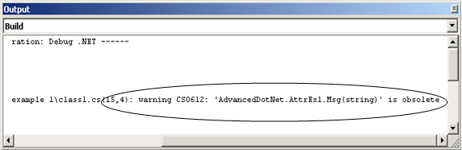
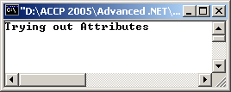
Build Window

Slide 27
Attributes - Syntax
[AttributeName(Parameters)]
[AnotherAttributeName(Parameters)]
MethodName(Parameters)
{
//method implementation
}

Slide 28
Customizing an Attribute
Attributes can be applied at class level or assembly level.
Attributes are saved with the metadata of a .NET framework file.
Obsolete attribute displays a standard warning message, specifying the method name and a standard message.
Customizing the message that is displayed by the obsolete attribute is also possible.

Slide 29
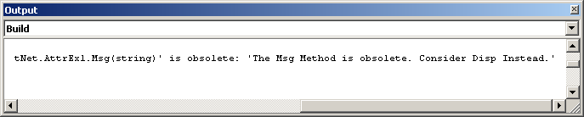
Customizing an Attribute(2)
...
[Obsolete("The Msg Method is obsolete. Consider Disp Instead. ")]
public static void Msg(string msg)
{
Console.WriteLine(msg);
}
...

Slide 30
Built-in Attributes
The most commonly used attributes are -
Conditional
Used to conditionally prevent or allow execution of a block of code
Dll
Import
Used for interoperability with legacy and unmanaged code

Slide 31
Conditional attribute
Takes in a single parameter - the name for a symbol.
The method which is marked by a Conditional attribute should always be marked with the return type void.
Can be used to assist in debugging.

Slide 32
Conditional attribute
using System;
using System.Diagnostics;
namespace AdvancedDotNet
{
class AttrEx2
{
[Conditional("DEBUG")]
public static void Msg(string msg)
{
Console.WriteLine(msg);
}
static void Main(string[] args)
{
Console.WriteLine("Before calling Msg()");
Msg("Trying out Attributes");
Console.ReadLine();
}
}
}

Slide 33
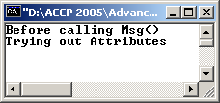
Conditional Attribute
Output of the example compiled in the Debug version
Ensures that the Msg() will be used only in debug versions of the solution and any calls to it from anywhere in the code in the release version will be ignored

Slide 34
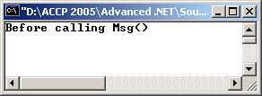
Conditional Attribute
Output of the example compiled in the Release version.

Slide 35

Debug / Release Mode
Setting the Debug / Release mode of an application
Conditional attribute can also be used to perform checks on whether a symbol has been defined or not.

Slide 36
A named ‘Symbol’
Going back to the the first example
using System;
using System.Diagnostics;
namespace AdvancedDotNet
{
class AttrEx2
{
[Conditional("DEBUG")]
public static void Msg(string msg)
…
}
}
Symbol

Slide 37
Conditional Attribute with Symbol Definition
#define USD
using System;
using System.Diagnostics;
namespace AdvancedDotnet
{
class AttrEx3
{
[Conditional("USD")]
public static void Convt(double amt)
{
double cAmt = amt *104.99;
Console.WriteLine("Amount in Japanese Yen :{0}",cAmt);
}
static void Main(string[] args)
{
Console.WriteLine("Enter Quantity to Purchase : ");

Slide 38
int qty = Convert.ToInt32(Console.ReadLine());
Console.WriteLine("Enter Unit Price of the item : "); double price = Convert.ToDouble(Console.ReadLine());
double amt=qty * price;
Console.WriteLine("Amount Payable in USD: {0}", amt);
Convt(amt);
Console.ReadLine();
}
}
}

Slide 39
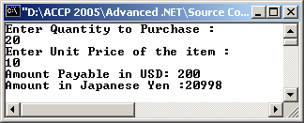
Conditional Attribute with Symbol Definition

Slide 40
DllImport Attribute
Dll -
Dynamic Link Library
Windows developers can package code and distribute for reuse
C# provides the DllImport attribute for interoperability with Windows DLLs
Used to interoperate with code in unmanaged and legacy components

Slide 41
DllImport Attribute
Unmanaged code refers to code generated outside .NET
The methods contained within these DLLs can be called within C# programs using the DllImport attribute.
While working with legacy code, we need to import the System.Runtime.InteropServices namespace

Slide 42
DllImport Attribute
using System;
using System.Runtime.InteropServices;
namespace AdvancedDotNet
{
class AttrEx4
{
[DllImport("D:\\Calc.dll", EntryPoint="Add")]
public static extern int Add(int Var1, int Var2);
static void Main(string[] args)
{
int r = Add(5,2);
Console.WriteLine("Result : {0}",r);
Console.ReadLine();
}
}
}

Slide 43
Microsoft Platform SDK
Microsoft Window’s programming interface, also known as “Microsoft Platform Software Development Kit”, provides tools for writing user and system software to run under Windows
SDK provides the operating system interface, thus affecting the performance, safety, and ease of Windows programming.
The core SDK Application Programming Interface covers an extremely broad area providing a wide array of interfaces

Slide 44
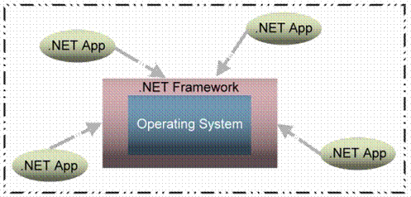
Base Class Library
In making programming simpler .NET introduces the BCL ( Base Class Library)
All .NET applications that execute in a managed execution environment talk to the .NET framework.

Slide 45
Using Win32 API
using System;
using System.Runtime.InteropServices;
using System.Diagnostics;
namespace AdvancedDotNet
{
class AttrEx5
{
[DllImport("User32.dll")]
public static extern int MessageBox(int hParent, string Message, string Caption, int Type);
static void Main(string[] args)
{
MessageBox(0,"Hello!","API MessageBox",0);
}
}
}

Slide 46
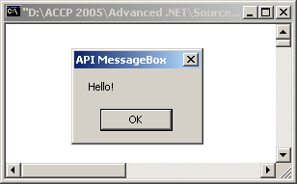
Using Win32 API

Slide 47
Creating Custom Attributes
Custom attributes provide properties that allow storage and retrieval
Creating a custom attribute first involves creating a custom class for the attribute, which would hold the implementation code
Snippet of a code with a custom attribute named Author defined in it:
[Author("Scooby")]
public void CalculateDistance()
{
//Method Implementation
}

Slide 48
Creating Custom Attributes
Author attribute should display a warning at compile time specifying the method name, and specifying the name of the author.
Author attribute should be applied to methods.

Slide 49
Creating Custom Attributes
[AttributeUsage(AttributeTargets.Method, AllowMultiple = false, Inherited = false)]
public class AuthorAttribute : Attribute
{
private string aName;
public AuthorAttribute(string aName)
{
this.name = aName;
...

Slide 50
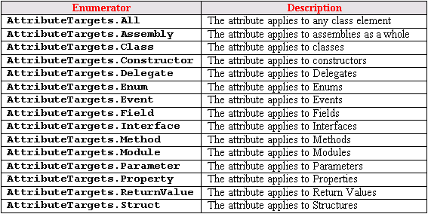
Enumerators

Slide 51
Example Rewritten
[AttributeUsage(AttributeTargets.Method | AttributeTargets.Property | AttributeTargets.Struct, AllowMultiple = false,Inherited = false)]
public class AuthorAttribute : Attribute
{
private string aName;
public AuthorAttribute(string aName)
{
this.name = aName;
...

Slide 52
Example with Constructor
Same example with a constructor in the class
[AttributeUsage(AttributeTargets.Method | AttributeTargets.Property | AttributeTargets.Struct, AllowMultiple = false,Inherited = false)]
public class AuthorAttribute : Attribute
{
private string aname;
public AuthorAttribute(string aName)
{
this.aname = aName;
}
}

Slide 53
Example – Author Attribute
using System;
namespace AdvancedDotNetOne
{
[AttributeUsage(AttributeTargets.Class| AttributeTargets.Property|AttributeTargets.Struct, AllowMultiple=false,Inherited=false)]
public class AuthorAttribute : Attribute
{
private string aname;
public AuthorAttribute(string aName)
{
this.aname =aName;
}

Slide 54
public string Info()
{
return aname;
}
}
[Author("IceCube")]
public class AttrEx6
{
public static int Convt(int val)
{
return(val*50);
}
}
}

Slide 55
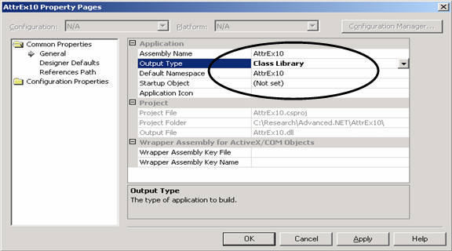
Creating an Assembly

Slide 56
Reading Metadata from Assemblies
using System;
using System.Reflection;
using AdvancedDotNetOne;
namespace AdvancedDotNet
{
class AttrEx7
{
static void Main(string[] args)
{
Assembly myattb = Assembly.Load("AttrEx6");
Type t = typeof(AttrEx6);
Console.WriteLine("Author information for {0} is", t);

Slide 57
Attribute[] attrs = Attribute.GetCustomAttributes(t);
AuthorAttribute auth = (AuthorAttribute)attrs[0];
Console.WriteLine(auth.Info());
Console.WriteLine();
}
}
}

Slide 58
Summary
An attribute is a declarative tag which can be used to provide information to the runtime about the behaviour of the C# elements such as classes and assemblies.
With attributes, C# provides a convenient technique that will handle tasks such as changing the behaviour of a method at runtime; perform compile time operations; or maybe even handle unmanaged code.
Built-in attributes include,
Obsolete
DllImport
Conditional
The Win32 API is made up of a set of Dlls. These Dlls contain the methods necessary for invoking the necessary system calls.

Slide 59
Summary
It might so happen that a situation arises when none of the attributes provided by the .NET framework satisfy our requirements. In such a case, one can create custom attributes.
A .NET component is a piece of executable code. It is also referred to as assembly.
The features of assemblies are:
Self Describing
Versioning
Zero-Impact Installations
Assemblies (or rather .NET components) expose their metadata through a process known as Reflection

